Slide 1

ECE 2001 Basic Circuit Theory
Lecture 9
Frequency Response and Introduction to Filters

Slide 2
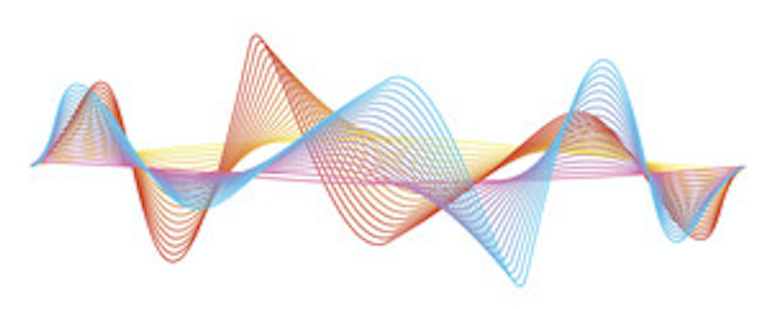
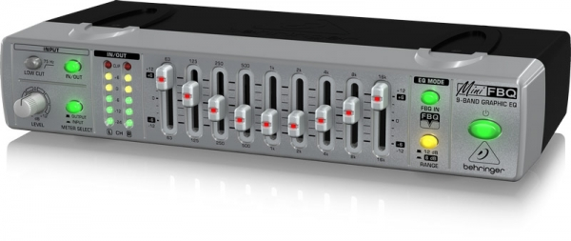
Overview
Frequency response, transfer function, and Bode plots
Resonance
Introduction to filters

Slide 3
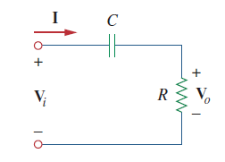
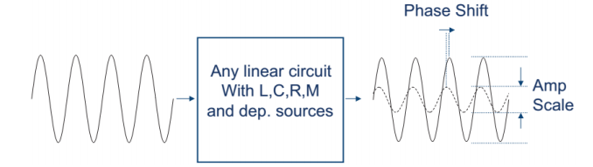
Part I. Frequency Response
In our sinusoidal circuit analysis, we have learned how to find voltages and currents in a circuit with a constant frequency source.
When a linear, time invariant (LTI) circuit is excited by a sinusoid, it’s output is a sinusoid at the same frequency.
  Only the magnitude and phase of the output differ from the input.

Slide 4
Frequency Response
If we let the amplitude of the sinusoidal source remain constant and vary the frequency, we obtain the circuit’s frequency response.
This is significant for applications involving filters, communications and control systems.
Filters play critical roles in blocking or passing specific frequencies or ranges of frequencies; without them, it would be impossible to have multiple channels of data in radio communications.
Frequency response is the variation in a circuit’s behavior with change in signal frequency.

Slide 5
Wireless Communication System

Slide 6

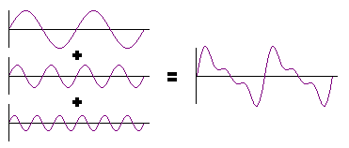
Understanding Signals at Different Frequencies
It might be a bit indirect since we cannot see or feel the frequencies.
Actually all real-world signals are sums of sinusoids components with different amplitudes, frequencies and phases.
For example, the sound and music.
Through vibration, the sound wave is created and propagated. Our ears detect the frequency and perceive as the pitch of a musical tone.
The higher the frequency of a waveform, the higher the pitch of the sound you hear.
But normally, the sound wave is made up of waveforms with different frequencies.

Slide 7
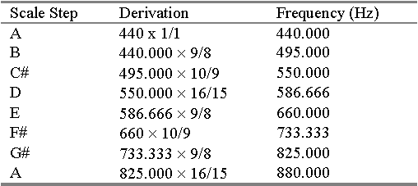
Frequency Range of Selected Signals
When we listen to music, our ears respond differently to the various frequency components: some pleasing, whereas others are not.
Design of signal-processing circuits for audio signals must consider how the circuit responds to components of different frequencies.
The frequency components of the signals (not only for sound) can be determined by theoretical analysis or by laboratory measurements (e.g. Spectrum Analyzer)

Slide 8
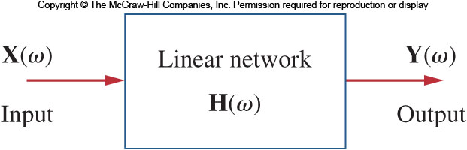
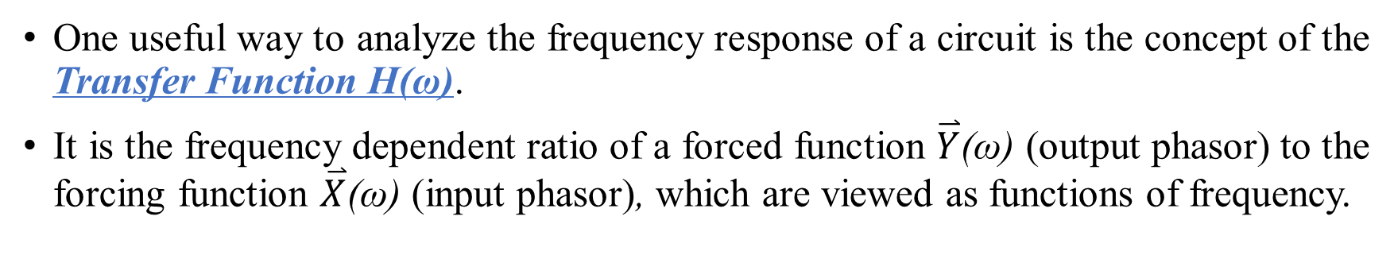
Transfer Function
One useful way to analyze the frequency response of a circuit is the concept of the Transfer Function H(ω).
It is the frequency dependent ratio of a forced function $\overset{⃑}{Y}$(ω) (output phasor) to the forcing function $\overset{⃑}{X}$(ω) (input phasor), which are viewed as functions of frequency.
Four possible input/output combinations

Slide 9
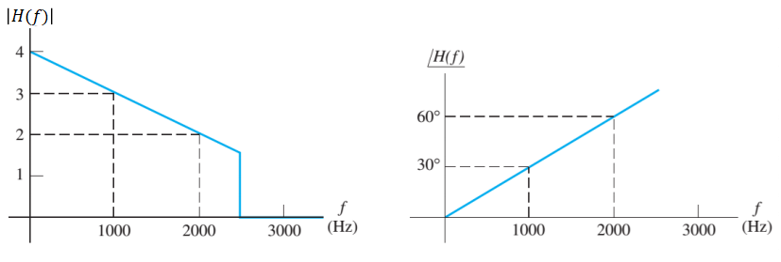
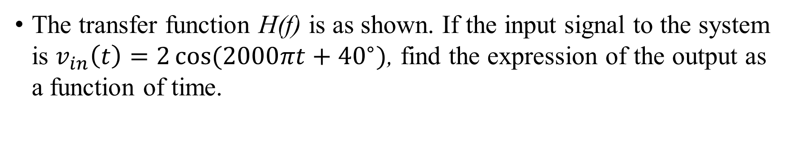
Example 1
The transfer function H(f) is as shown. If the input signal to the system is $v_{in}\left(t\right)=2\cos{(2000πt+{40}^{∘})}$, find the expression of the output as a function of time.
What if the input signal is: $v_{in}\left(t\right)=3+2\cos\left(2000πt\right)+\cos{(4000πt−{70}^{∘})}$

Slide 10
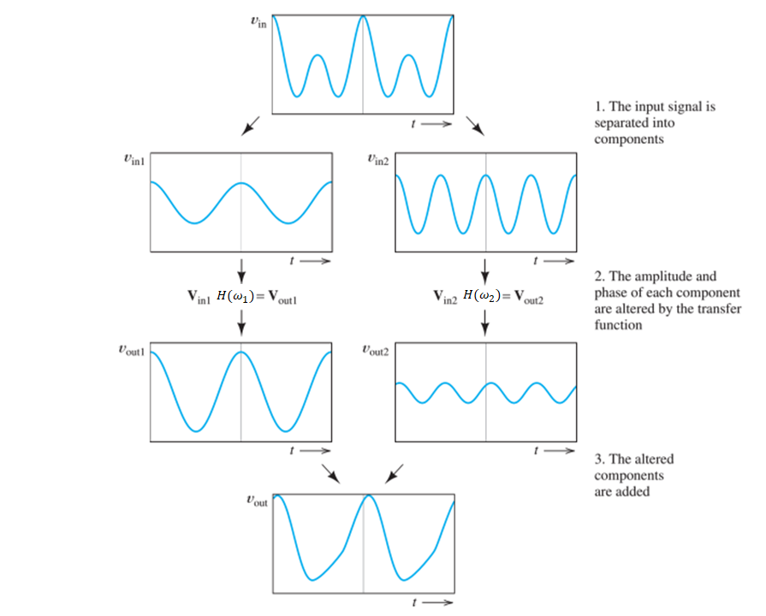

Slide 11
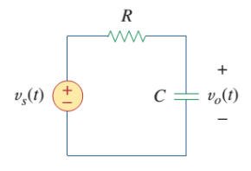
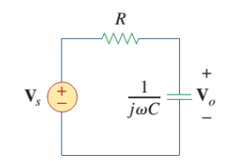
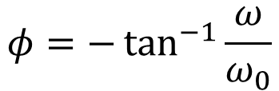
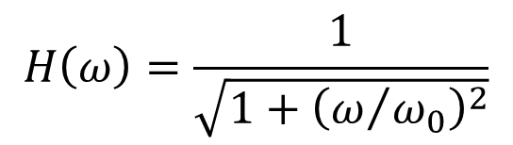
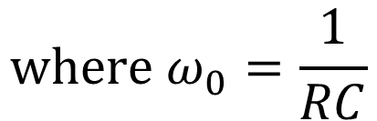
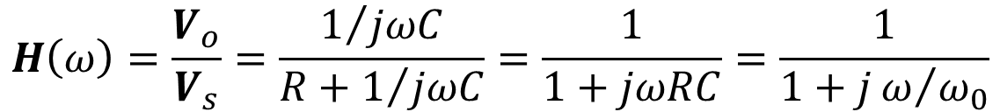
Example 2
Find the transfer function of the RC circuit.
$$H\left(ω\right)=\frac{V_{o}}{V_{s}}=\frac{1/{jωC}}{R+1/{jωC}}=\frac{1}{1+jωRC}=\frac{1}{1+jω/{ω_{0}}}$$
$$H\left(ω\right)=\frac{1}{\sqrt{1+{\left(ω/{ω_{0}}\right)}^{2}}}$$
$$φ=−\tan^{−1}{\frac{ω}{ω_{0}}}$$
$$where ω_{0}=\frac{1}{RC}$$

Slide 12
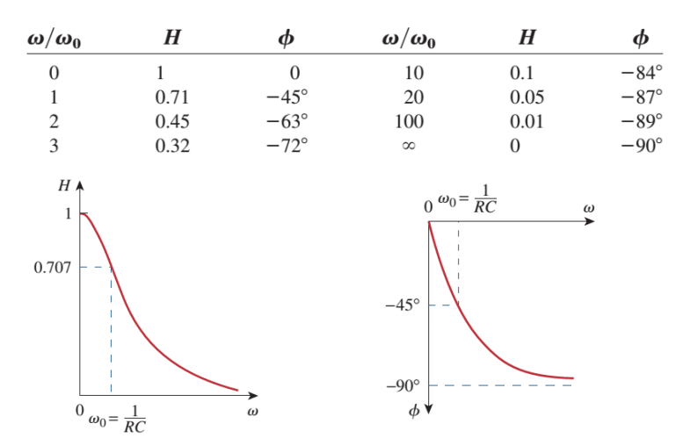
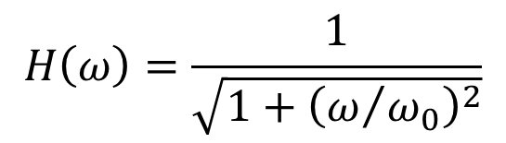
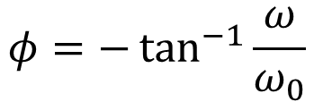
$$H\left(ω\right)=\frac{1}{\sqrt{1+{\left(ω/{ω_{0}}\right)}^{2}}}$$
$$φ=−\tan^{−1}{\frac{ω}{ω_{0}}}$$
Plots of H and φ as a function of ω. A low pass filter!

Slide 13
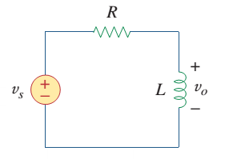
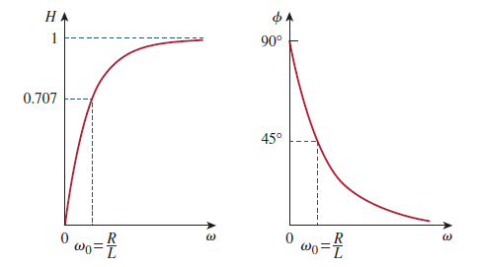
Practice
Obtain the transfer function of the voltage gain of the RL circuit.

Slide 14
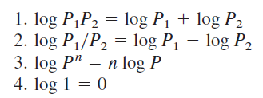

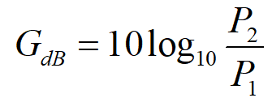
Decibel Scale
It is a more systematic way of obtaining the frequency response is to use the Bode Plots on logarithmic scales.
In communications systems, gain is measured in bels, or more commonly decibels (db=1/10 of a bel). Historically, the decibel scale is used to measure the ratio of two levels of power or power gain G; that is,
The transfer function can be seen as an expression of gain.

Slide 15
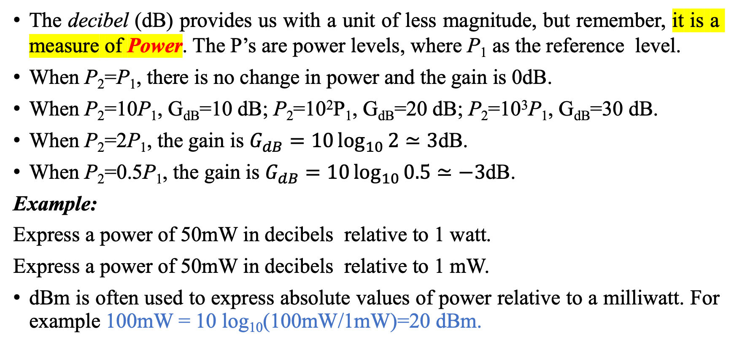
Decibel Scale
The decibel (dB) provides us with a unit of less magnitude, but remember, it is a measure of Power. The P’s are power levels, where P₁ as the reference level.
When P₂=P₁, there is no change in power and the gain is 0dB.
When P₂=10P₁, G_{dB}=10 dB; P₂=10²P₁, G_{dB}=20 dB; P₂=10³P₁, G_{dB}=30 dB.
When P₂=2P₁, the gain is $G_{dB}=10\log_{10}{2}≃3$dB.
When P₂=0.5P₁, the gain is $G_{dB}=10\log_{10}{0.5}≃−3$dB.
Example:
Express a power of 50mW in decibels relative to 1 watt.
Express a power of 50mW in decibels relative to 1 mW.
dBm is often used to express absolute values of power relative to a milliwatt. For example 100mW = 10 log₁₀(100mW/1mW)=20 dBm.

Slide 16
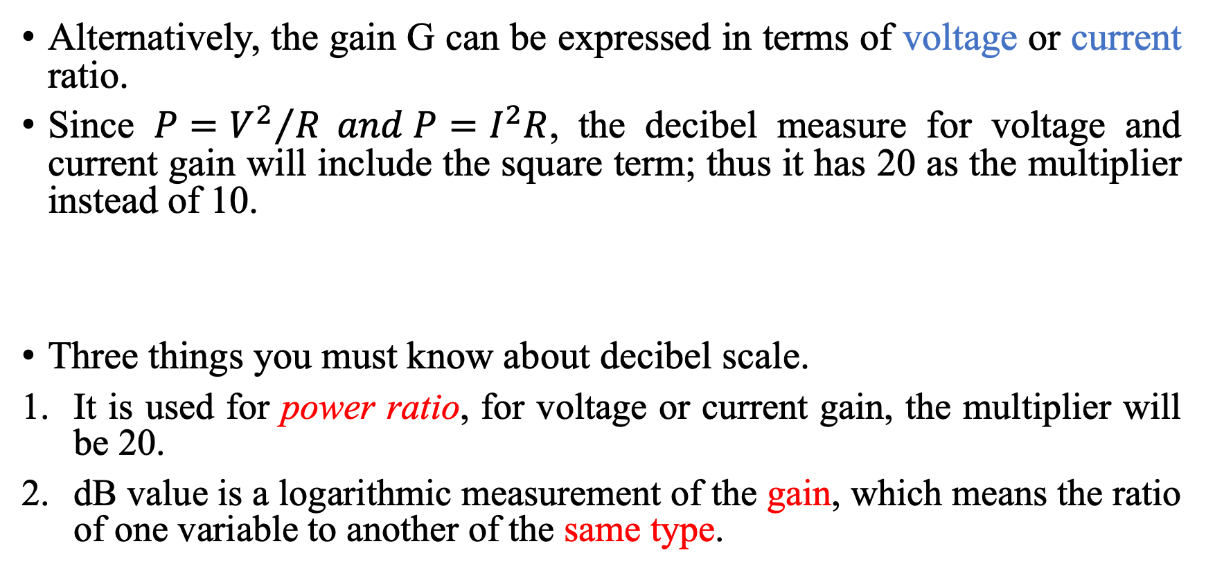
Decibel Scale
Alternatively, the gain G can be expressed in terms of voltage or current ratio.
Since $P={V^{2}}/R and P=I^{2}R$, the decibel measure for voltage and current gain will include the square term; thus it has 20 as the multiplier instead of 10.
Three things you must know about decibel scale.
It is used for power ratio, for voltage or current gain, the multiplier will be 20.
dB value is a logarithmic measurement of the gain, which means the ratio of one variable to another of the same type.

Slide 17
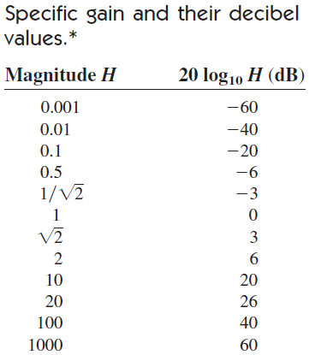

Bode Plots
One problem with the transfer function is that it needs to cover a large range in frequency, where we can use Bode Plots
Bode plots are log-log plots: the magnitude (in dB) and phase (in degrees) of a transfer function versus logarithm of frequency.
The real part is a function of the magnitude while the imaginary part is the phase,

Slide 18
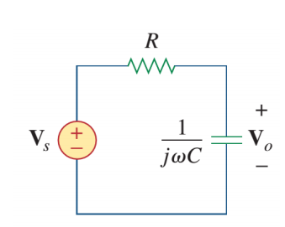
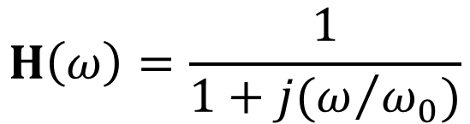
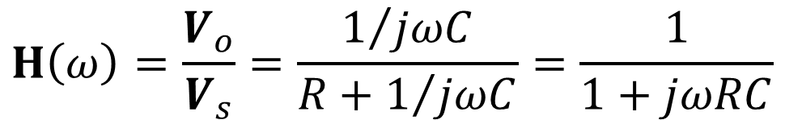
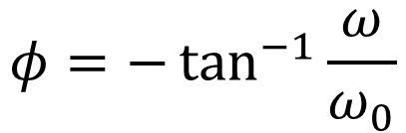
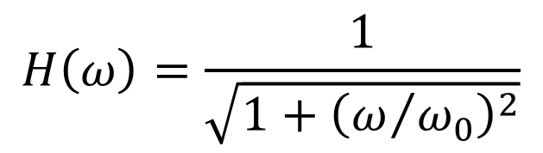
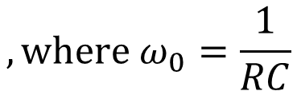
Start from an Example
$$H\left(ω\right)=\frac{V_{o}}{V_{s}}=\frac{1/{jωC}}{R+1/{jωC}}=\frac{1}{1+jωRC}$$
$$H\left(ω\right)=\frac{1}{1+j(ω/{ω_{0}})}$$
$$, where ω_{0}=\frac{1}{RC}$$
The Amplitude is:
The Phase is:
$$H\left(ω\right)=\frac{1}{\sqrt{1+{\left(ω/{ω_{0}}\right)}^{2}}}$$
$$φ=−\tan^{−1}{\frac{ω}{ω_{0}}}$$

Slide 19
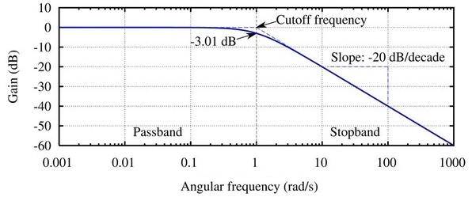
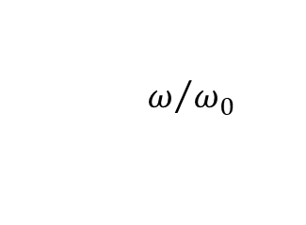
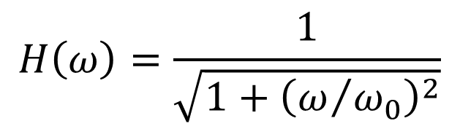
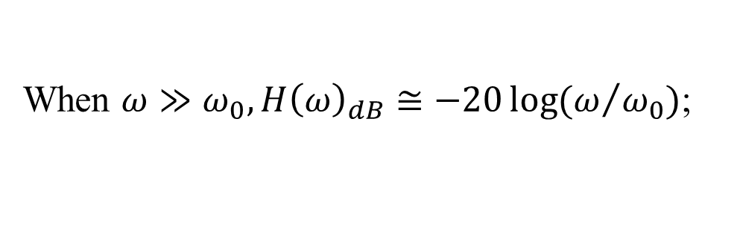
Magnitude Plot
$$H\left(ω\right)=\frac{1}{\sqrt{1+{\left(ω/{ω_{0}}\right)}^{2}}}$$
Convert magnitude to decibels,
$$H{\left(ω\right)}_{dB}=20\log{H(ω)}=−10\log\left[1+{\left(ω/{ω_{0}}\right)}^{2}\right]$$
When $ω≪ω_{0}, \text{i}\text{.}\text{e}\text{., }\text{at} \text{low} \text{frequency}\text{,} H{\left(ω\right)}_{dB}≅0$;
When $ω≫ω_{0}, H{\left(ω\right)}_{dB}≅−20\log{(ω/{ω_{0}})}$;
or corner frequency
ω | H(ω)_{dB}
ω₀ | -3
2ω₀ | -7
10ω₀ | -20
100ω₀ | -40
$$ω/{ω_{0}}$$

Slide 20
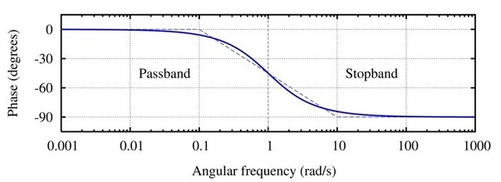
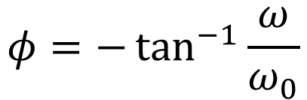

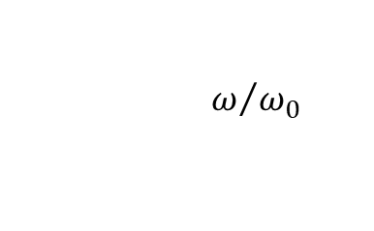
* Phase Plot
$$φ=−\tan^{−1}{\frac{ω}{ω_{0}}}$$
When $ω<{ω_{0}}/{10}, i.e., low frequency, φ≅0;$
When$ω>10ω_{0}, φ≅−{90}^{∘}.$
The actual phase curve departs from these straight-line approximations by less than 6°
dash line: approximation
$$ω/{ω_{0}}$$

Slide 21
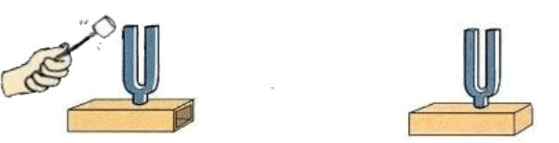
Part II. Resonance
The most prominent feature of the frequency response of a circuit may be the sharp peak in the amplitude characteristics.
Electrical resonance requires at least one capacitor and one inductor.
It enables energy storage in the form of oscillations
Resonance circuits are useful for constructing filters as their transfer function can be highly frequency selective.
  Resonance is a condition in an RLC circuit in which the capacitive and inductive reactances are equal in magnitude, thereby resulting in a purely resistive impedance.

Slide 22
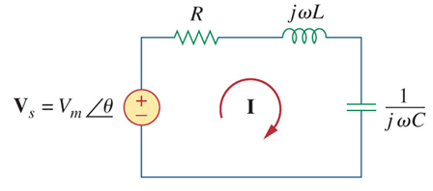

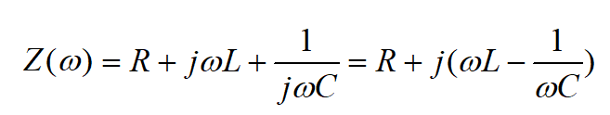
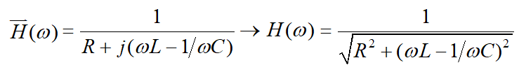
Series Resonance
Consider the series resonant circuit consisting of an inductor and capacitor.
Define I as output and V_{s} as input, the
transfer function is

Slide 23
Resonance occurs when
  The transfer function magnitude at its max
  Or equivalently, the impedance is purely resistive
The corresponding value of ω or f is called the resonant frequency

Slide 24
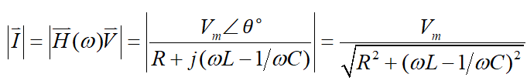
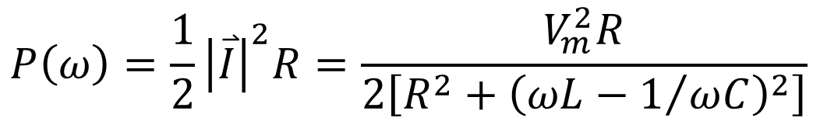
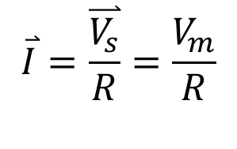
Series Resonance: current is maximized; power is maximized
Current magnitude
Power dissipation
At resonance
$$P\left(ω\right)=\frac{1}{2}{\left|\overset{⃑}{I}\right|}^{2}R=\frac{V_{m}^{2}R}{2\left[R^{2}+{\left(ωL−1/{ωC}\right)}^{2}\right]}$$
$$\overset{⃑}{I}=\frac{\overset{⃑}{V_{s}}}{R}=\frac{V_{m}}{R}$$

Slide 25

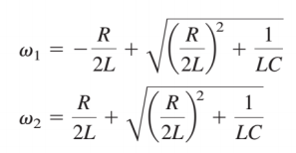
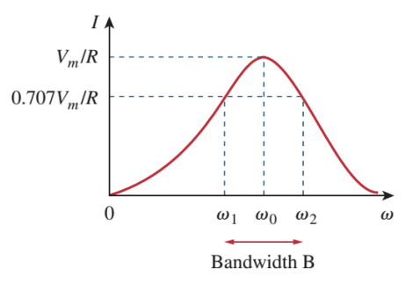

Half-Power Frequencies
There are two frequencies above and below resonance where the dissipated power is half the max:
  Half power points
From the above solution, one can easily show that:
$$ω_{0}=\sqrt{ω_{1}ω_{2}}$$

Slide 26


Bandwidth and Quality Factor
Although the height of the curve is determined by R, the width depends on other factors.
The width of the response curve is commonly measured using bandwidth
The “sharpness” of the resonance peak is measured quantitatively by the quality factor Q.

Slide 27









Quality Factor – Q
Quality factor is defined as
Notice that the quality factor is dimensionless
The quality factor of a resonant circuit is the ratio of its resonant frequency to its bandwidth.
$$⟹$$
or

Slide 28

The higher the Q the higher and narrower the resonant peak; lower Q results in wider bandwidth.
The higher the Q, the more selective the circuit
  The selectivity of an RLC circuit is the ability of the circuit to respond to a certain frequency and discriminate against all other frequencies.
For high-Q circuits (Q>10, R/L ↓) the half-power frequencies are, for all practical purposes, symmetrical around the resonant frequency and can be approximated as:

Slide 29


Series Circuit at Resonance
Resonant frequency
At resonance:
  The impedance is purely resistive.
  V and I are in phase, so unity power factor.
  The inductor voltage and capacitor voltage can be much higher than the source voltage
  the reactive energy in the circuit oscillates between the inductor and the capacitor.
At resonance

Slide 30





Example
In the circuit, find the following
Resonant frequency
Quality factor
Bandwidth
Half-power frequnecies

Slide 31
Parallel Resonance
The parallel RLC circuit shown here is the dual of the series circuit shown previously.
Resonance here occurs when the imaginary part of the admittance is zero, with dual
This results in the same resonant frequency as in the series circuit.

Slide 32





Parallel Resonance
The relevant equations for the parallel resonant circuit are:
Again, for high-Q circuits (Q ≥10)

Slide 33

Parallel Circuit at Resonance
Resonant frequency
At resonance:
  The impedance is purely resistive.
  V and I are in phase, so unity power factor.
  Notice that at resonance, the parallel LC combination acts like an open circuit, so that the entire current flows through R. The inductor current and capacitor current can be much higher than the source voltage
  the reactive energy in the circuit oscillates between the inductor and the capacitor.
At resonance

Slide 34

Comparison

Slide 35

Part III. Introduction to Filters
A filter is a circuit that is designed to pass signals with desired
frequencies and reject or attenuate others.
A filter is passive if it consists only of passive elements, R, L, and C.
They are very important circuits in that many technological advances
would not have been possible without the development of filters.

Slide 36

Type of Filters
Ideal frequency response for filters
Lowpass passes only low frequencies and blocks high frequencies.
Highpass does the opposite of lowpass
Bandpass only allows a range of frequencies to pass through.
Bandstop does the opposite of bandpass
Cutoff frequency ω_{c}
Cutoff frequency:
For ideal filters, the frequency that separates the passband and stopband
For practical filters, the half-power (relative to passband) frequencies that separate the pass band and stopband.

Slide 37



First-Order Lowpass Filter
A typical lowpass filter is formed when the output of a RC circuit is taken off the capacitor.
Transfer function:
The half power frequency is:
  The filter is designed to pass from DC up to ω_{c}
Of course, there are many other circuits for lowpass filters
  A lowpass filter can also be formed when the output of an RL circuit is taken off the resistor.

Slide 38



First-Order Highpass Filter
A highpass filter can also be made of a RC circuit, with the output taken off the resistor.
Transfer function:
The cutoff frequency will be the same as the lowpass filter.
  A highpass filter is designed to pass all requencies above its cutoff frequency
A highpass filter can also be formed when the output of an RL circuit is taken off the inductor.

Slide 39

First-Order Filter Circuits

Slide 40



Bandpass Filter
A bandpass filter is designed to pass all frequencies within a band of frequencies. It can be realized by taking the output from the resistor in an RLC series circuit.
Transfer function
The center frequency is:
The filter will pass frequencies from ω₁ to ω₂. The difference is the passband bandwidth

Slide 41



Bandstop Filter
A bandstop filter is designed to stop or eliminate all
frequencies within a band of frequencies. A bandstop filter can be created from a RLC circuit by taking the output from the LC series combination.
Transfer function:
Therefore, the range of blocked frequencies will be the same as the range of passed frequencies for the bandpass filter.
Here is called frequency of rejection.
And is the bandwidth of rejection.

Slide 42








Example
Determine what type of filter. Calculate the cutoff frequency, take R=2 kΩ, L=2 H, and C=2 μF.
→likely second order lowpass filter
Magnitude is
Half-power frequency:

Slide 43
Active Filters
Passive filters have a few drawbacks.
  They cannot create gain greater than 1 (first order filters) or cannot control the gain easily.
  They may require bulky and expensive inductors.
  They perform poorly at frequencies below the audio range. (300 Hz ~ 3,000Hz)
Nevertheless, passive filters are useful at high frequencies.
It is possible, using op-amps, to create all the common filters, AKA Active Filters.
  They are often smaller and less expensive.
  They can provide additional amplifier gain
  They can be combined with buffer amplifiers (voltage followers) to isolate each stage of the filter from source and load impedance effects
Pros
Cons
  are less reliable and less stable
  practical frequency limit of about 100kHz

Slide 44

First Order Active Filter
One of the components must be reactive.
The components selected for Z_{i} and Z_{f} determine whether the filter is lowpass or highpass.
For the general first order filter, the transfer function is

Slide 45

First Order Lowpass
For Z_{i}=R_{i}, Z_{f}=R_{f} //C_{f}, the circuit acts as a lowpass filter
Similar to a passive RC lowpass, except for the gain R_{f} /R_{i}.
At high ω, C_{f} is short, the gain is 0, input signal does not pass through; at low ω, C_{i} is open, the circuit is an inverting amp, signal passes through.
Several inputs with different R_{i}’s could be summed if required, and the cutoff frequency would remain the same for each input.

Slide 46

First Order Highpass
Placing a series RC combination in place of the input resistor yields a highpass filter.
Transfer function
The corner frequency of the filter will be:
Again this is similar to the passive highpass, except with a gain.
At high ω, C_{i} is short, the circuit is an inverting amp of gain R_{f}/R_{i}, input signal passes through; at low ω, C_{i} is open, V_{o}=0, no signal passes through.

Slide 47



Active Bandpass
To avoid the use of an inductor, it is possible to use a cascaded series of lowpass active filter into a highpass active filter.
To prevent unwanted signals passing, their gains are set to unity, with a final stage for amplification.

Slide 48


Active Bandpass
The analysis of the bandpass filter is relatively simple
Transfer function:
Note: the highpass section sets the low corner frequency, while the lowpass section sets the high corner frequency
The overall gain is simply a product of the gains of the individual section because of the small output impedance of op-amps (ideally 0).

Slide 49
* Active Bandpass
The center frequency, bandwidth, and quality factor are found as follows,
The passband gain is (at mid-band)
Note: the results are simple because the same R is used for both the low and highpass sections.

Slide 50


* Active Bandstop
In the same way, creating a bandstop filter requires using a lowpass and highpass filter in parallel, and both output are fed into a summing amplifier, as shown below:
It will function by amplifying the desired signals compared to the signal to be rejected.

Slide 51


* Active Bandstop
Transfer function
The gain at center frequency is
This filter only attenuates the midband frequencies
Better and more complex other kinds of active filters can be designed.

Slide 52
Expected learning outcome
Be able to explain/express the following concepts:
  Frequency response
  Transfer function
  Resonant frequency, bandwidth, and quality factor (Q) of a resonant circuit
  Bandwidth and/or center frequency of lowpass, highpass, bandpass, bandstop filters
Be able to find the transfer function and, based on the transfer function, discuss the characteristics (such as lowpass, highpass) of a circuit.

